Slide 1
SWARM ROBOT: FARobot SMR Robot
Ikhwan bin Amir Hamzah (1812423)

Slide 2
History
The term ’swarm’ was first used in robotics by G. Beni and Fukuda in 1988. According to G. Beni, cellular robotics is composed of autonomous robots that operate in an n-dimensional cellular space without any central entity. Additionally, they coordinate and cooperate to accomplish common goals.
Fokuda used a swarm as a group of robots to work together like the cells of a human body. As a result, they could accomplish very complex goals. A year later, G. Beni and J. Wang introduced ‘swarm intelligence,’ claiming that cellular robotic systems could show intelligent behavior by coordinating their actions.
In 1993, C. Ronald Kube and Hong Zohng constructed a multi-robot system inspired by the collective behaviors of natural swarms. In the same year, Gregory Dudek defined swarm robotics based on their different features, including the size, communication range, communication topology, communication bandwidth, reorganization rate, abilities of the members, and swarm homo or heterogeneity.

Slide 3
History
Early swarm robotic systems explored swarming behaviors in species like ants, birds, fish, and others. The researchers examined these behaviors, exploring the ways how to realize these behaviors in different robotic systems. Additionally, research was driven by different inspirations, like the flocking of birds or colonies of ants.
However, in 2004, G. Beni made a fresh attempt to describe a swarm more precisely. According to him, robots in a swarm are simple, identical, and self-organizing. The system must be scalable, and only local communication is available among the swarm members. These properties are still considered the basics of defining and distinguishing swarm robotic systems from other robotic systems. According to G. Beni, the number of members in a swarm should be greater than 100 and much less than 1023.

Slide 4
History
The key characteristics of swarm robots are as follows:
Autonomy: Consists of autonomous robots that can physically interact with the environment.
Large number: Consists of limited homogeneous groups of robots in which each group contains a large number of members.
Limited capabilities: Each robot in the system is relatively incapable or inefficient in carrying out tasks independently, but they are highly efficient when they cooperate as a group.
Scalability & robustness: Scalable and robust. Increasing the number of units will improve the overall performance.
Distributed coordination: Coordination between robots is distributed. Each robot has local and limited sensing and communication abilities.

Slide 5
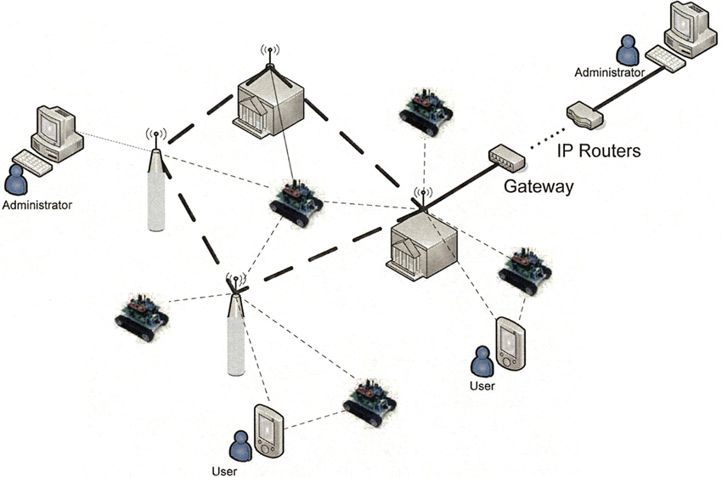
Basic System Architecture

Slide 6
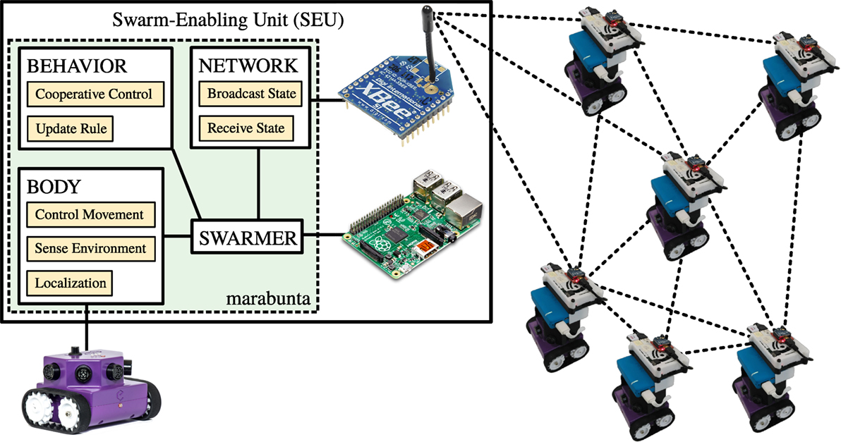
Basic System Architecture

Slide 7
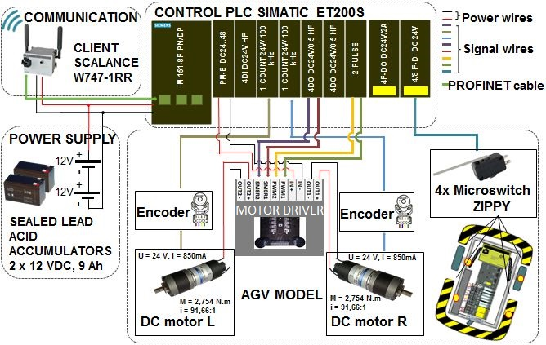
Basic System Architecture

Slide 8
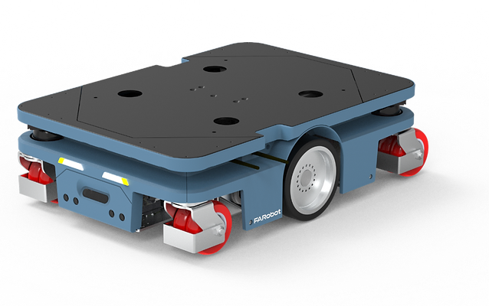
Robot Body Design vs Tasks
A robot that can understand and move through its environment independently using sophisticated sensors, artificial intelligence, machine learning, and compute for path planning to interpret and navigate through their environment, untethered from wired power
Standard protocols prove to be valuable tools for industrial-grade robotic solutions thus at FARobot, a proprietary protocol called Swarm Protocol is developed. It reduces AMR, AGV and equipment idle time, increases factory and warehouse throughput and standardize the onboarding of new robots.

Slide 9

Actuators/Locomotions

Slide 10

Actuators/Locomotions

Slide 11
Navigation System & Controllers
Swarm Core
Easy fleet management
Easy robot and equipment fleet onboarding at scale.
Drag and drop workflow design
Design complex workflow and event triggers through our user-friendly UI.
Hybrid Fleet management
Consolidate and orchestrate different brands of robots and equipment from one interface.
LiveView at scale
Oversee multiple fleet in different site in real-time.

Slide 12
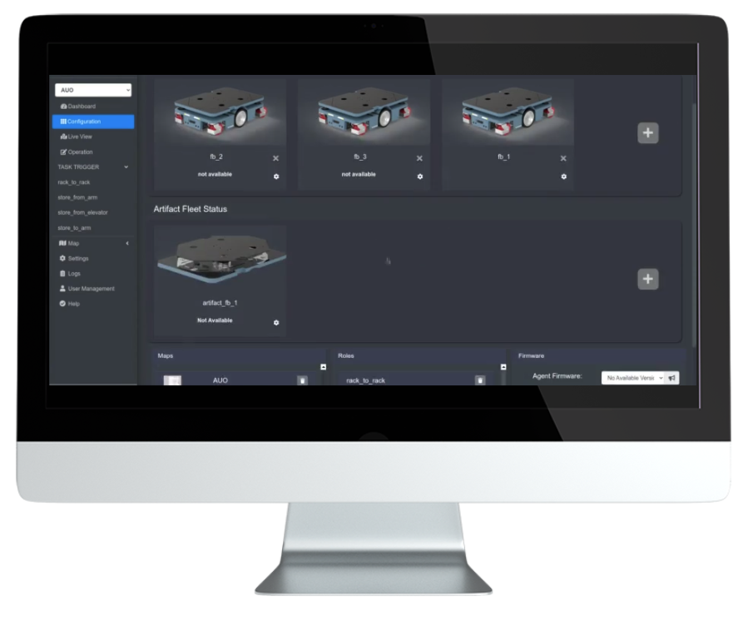
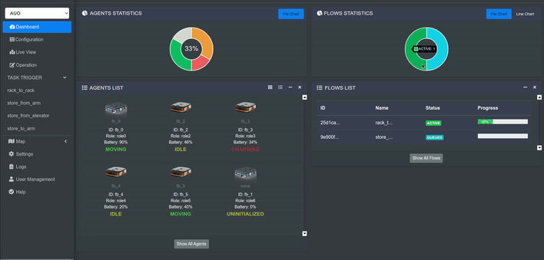
Controllers

Slide 13
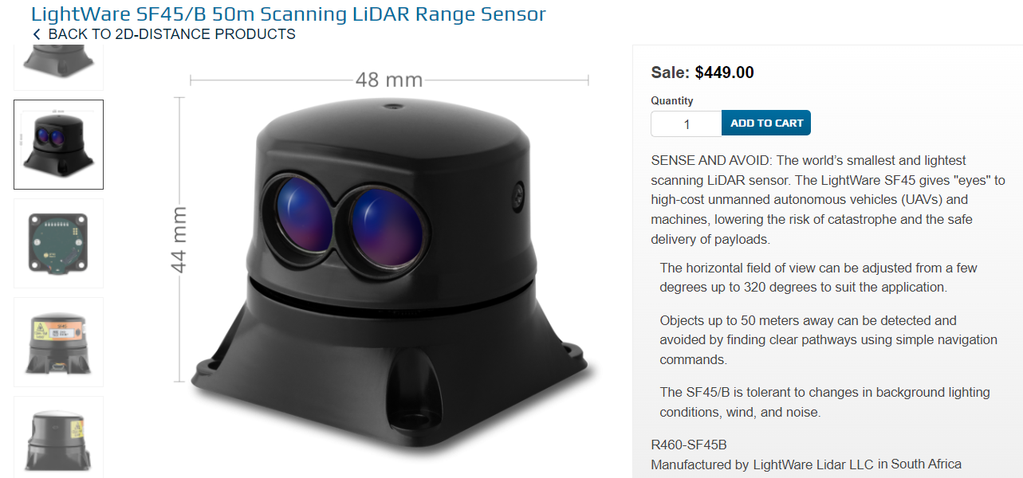
Data Collection

Slide 14
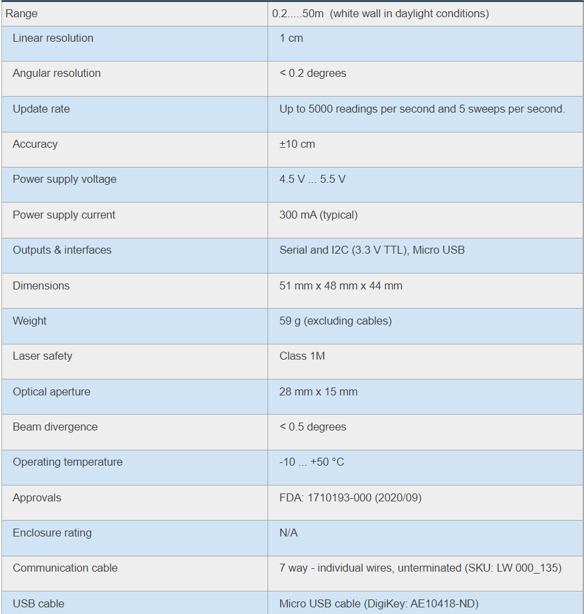
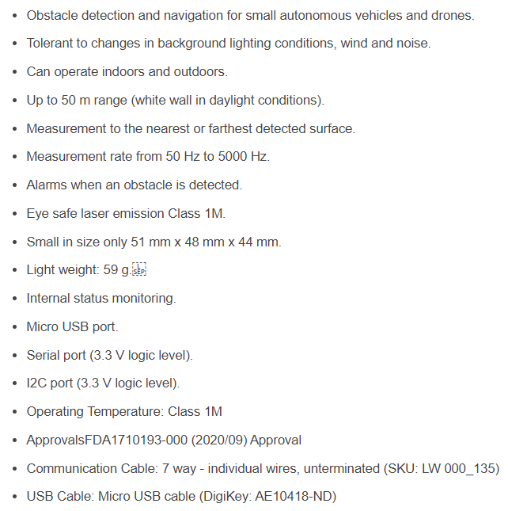
Data Collection

Slide 15
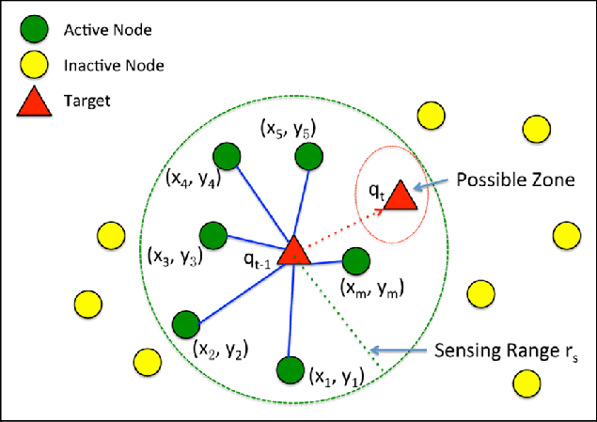
Data Collection
Localisation Sensor
Process of determining where a mobile robot is located with respect to its environment
A map of the environment is available, and the robot is equipped with sensors that observe the environment as well as monitor its own motion
Two of the most common probabilistic techniques, extended Kalman filter and particle filter, that can be used to combine information from sensors to compute an estimate the robot location allowing the robot to recognize its position

Slide 16
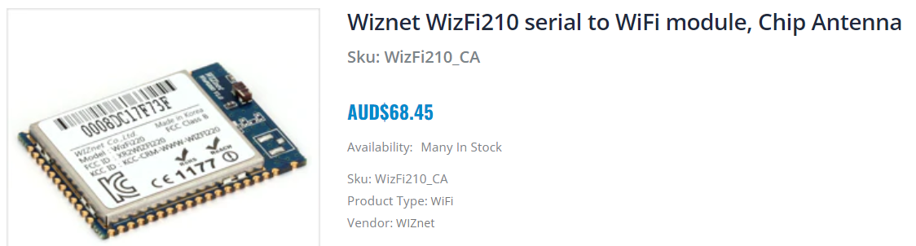
Data Transmission

Slide 17
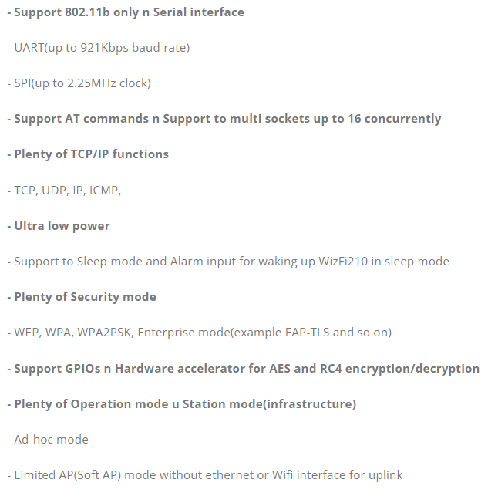
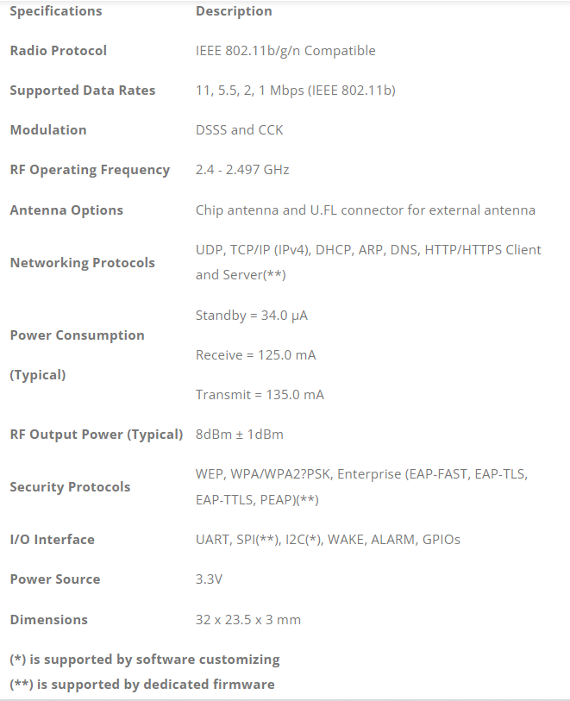
Data Transmission

Slide 18

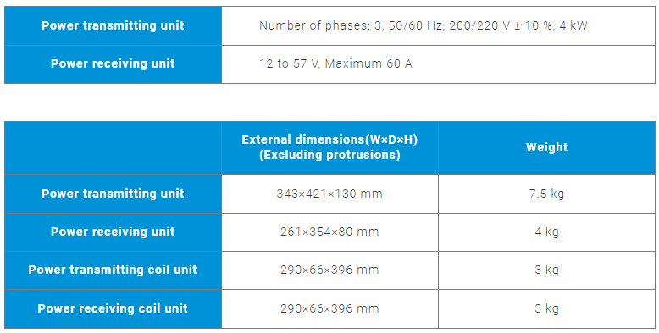
Power System Management

